Slide 1

CS411-Compiler Construction
Lexical Analysis
Talha Waheed, Dept. of CS, UET, Lahore, Pakistan.

Slide 2
Course Learning Objectives

Slide 3
Lexical Analysis

Slide 4
Role of the Lexical Analyzer
Break input into tokens for parser
Remove white space and comments
Insert symbols into symbol table
Simplifies design of grammar

Slide 5
Lexical Analyzer
Lexical Analyzer reads the source program character by character to produce tokens.
Normally a lexical analyzer doesn’t return a list of tokens at one shot, it returns a token when the parser asks a token from it.

Slide 6
Lexical Analyzer
source
program
Lexical
Analyzer
token
Parser
get next token
Symbol
Table

Slide 7
Terminology
Token
unit of lexical analysis returned to the parser (e.g., num, id, relop)
Lexeme
the character string representing a particular token
Pattern
description of the lexemes that match a token
Regular expressions are widely used to specify patterns.

Slide 8
Examples

Slide 9
Tokens and Attributes
Since a token can represent more than one lexeme, additional information should be held for that specific lexeme. This additional information is called as the attribute of the token.
Tokens generally have type and attribute

Slide 10
Tokens and Attributes
Attribute can be value or pointer (or index) into symbol table for entry
<id, “Abc”, 0> 0 is index into symbol table for variable “Abc”
<num, “3.455”, >
<ne, “!=”, >
<id, “B”, 2> 2 is index into symbol table for variable “B”
<if, “if”, >
Token type and its attribute uniquely identifies a lexeme.

Slide 11
Regular Expressions
We use regular expressions to describe tokens of a programming language.
A regular expression can be built up of simpler regular expressions
Each regular expression denotes a language.
A language denoted by a regular expression is called as a regular set.

Slide 12
Regular Definitions
Writing regular expression for some languages can be difficult, because their regular expressions can be quite complex. In those cases, we may use regular definitions.
We can give names to regular expressions, and we can use these names as symbols to define other regular expressions.

Slide 13
Regular Definitions (cont.)
Ex: Identifiers in Pascal
letter → A | B | ... | Z | a | b | ... | z
digit → 0 | 1 | ... | 9
id → letter (letter | digit ) *
If we try to write the regular expression representing identifiers without using regular definitions, that regular expression will be complex.
(A|...|Z|a|...|z) ( (A|...|Z|a|...|z) | (0|...|9) ) *

Slide 14
Regular Definitions (cont.)
Ex: Unsigned numbers
digit → 0 | 1 | ... | 9
digits → digit ⁺
opt-fraction → ( . digits ) ?
opt-exponent → ( E (+|-)? digits ) ?
unsigned-num → digits opt-fraction opt-exponent

Slide 15
Shorthand Notations
(a)⁺ denotes one or more instance
r* = r+ | ε
r+ = rr*
(r)? denotes zero or one instance
r? = r | ε
[a-z] denotes a|b|c|..|z

Slide 16
Examples
[a-zA-Z]⁺ denotes string of one or more characters
[a-zA-Z][a-zA-Z0-9] * denotes valid identifiers in Fortran
[0-9] ⁺(.[0-9] ⁺)?(E(+|-)?[0-9] ⁺)? denotes valid unsigned Pascal numbers

Slide 17
Transition Diagrams
Starting state
Edges labeled by characters causing transitions
b
a
a
a
b
0
1
2
b

Slide 18
Finite Automata
A recognizer for a language is a program that takes a string x, and answers “yes” if x is a sentence of that language, and “no” otherwise.
We call the recognizer of the tokens as a finite automaton.
A finite automaton can be: deterministic(DFA) or non-deterministic (NFA)
This means that we may use a deterministic or non-deterministic automaton as a lexical analyzer.

Slide 19
Finite Automata
Both deterministic and non-deterministic finite automaton recognize regular sets.
Which one?
deterministic – faster recognizer, but it may take more space
non-deterministic – slower, but it may take less space
Deterministic automatons are widely used lexical analyzers.
First, we define regular expressions for tokens; Then we convert them into a DFA to get a lexical analyzer for our tokens.

Slide 20
Deterministic Finite Automaton (DFA)
A Deterministic Finite Automaton (DFA) is a special form of a NFA.
no state has ε- transition
for each symbol a and state s, there is at most one labeled edge a leaving s.
i.e. transition function is from pair of state-symbol to state (not set of states)

Slide 21
Deterministic Finite Automaton (DFA)
b
a
a
a
b
0
1
2
b
The language recognized by this DFA is (a|b) * a b

Slide 22
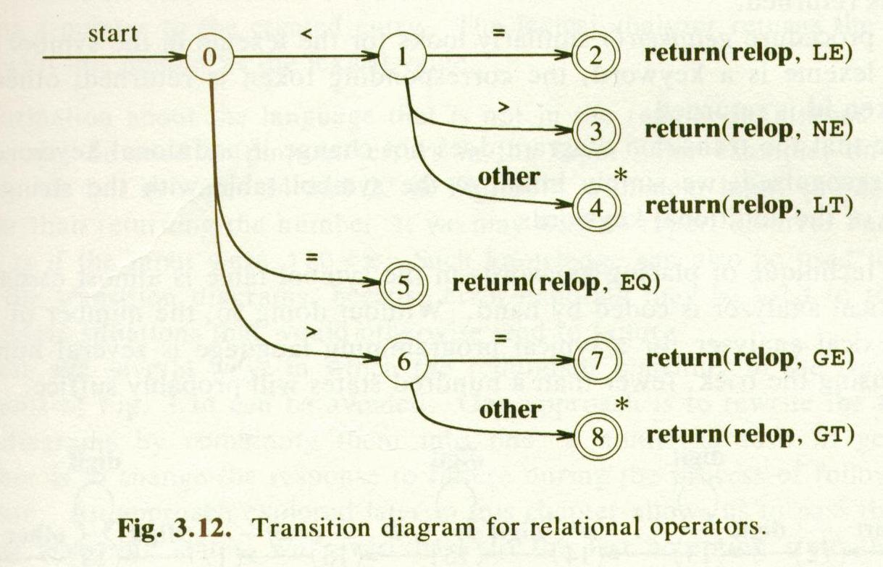
Transition Diagrams for Parts of Pascal

Slide 23
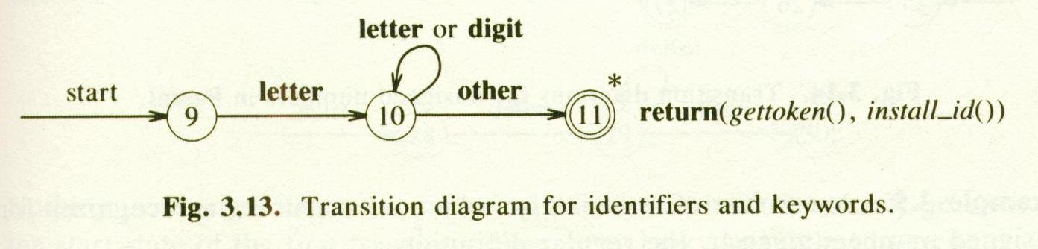
Transition Diagrams for Parts of Pascal

Slide 24
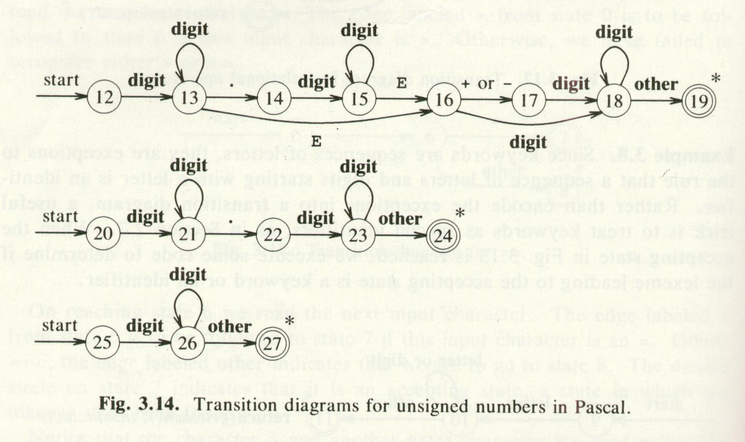
Transition Diagrams for Parts of Pascal

Slide 25
Implementing a Lexical Analyzer
An individual token is represented as an int value, returned by the lex function.
The set of possible lexical tokens returned by the lexical analyzer is defined as an enum type

Slide 26
enum Tokens {
andOp = 1, elseClause = 2, floatType = 3, ifStmt = 4,
intType = 5, notOp = 6, orOp = 7, readStmt = 8,
returnStmt = 9, whileStmt = 10, writeStmt = 11,
writelnStmt = 12, voidType = 13,
identifier = 50, intNum = 51, floatNum = 52,
…
};

Slide 27
Implementing a Lexical Analyzer
lex can return a struct containing
token
lexeme
index to symbol table entry
Position of the token in the file (for the error handling)
line number and character number within line
Assume some maximum lexeme length
const int MAXLENGTH = 50; // or any appropriate value

Slide 28
Some Issues in Lexical Analyzer
What is the end of a token? Is there any character which marks the end of a token?
It is normally not defined.
If the number of characters in a token is fixed, in that case no problem: + -
But < ➔ < or <=

Slide 29
Some Issues in Lexical Analyzer
The lexical analyzer has to recognize the longest possible string.
identifier newval --
n ne new newv newva newval

Slide 30
Some Issues in Lexical Analyzer
What is the end of a token? Is there any character which marks the end of a token?
The end of an identifier: the characters cannot be in an identifier can mark the end of token.
it is not feasible nor sensible to rely on the existence of white space to separate all tokens
We may need a look-ahead

Slide 31
Some Issues in Lexical Analyzer
Skipping comments
Normally we don’t return a comment as a token.
We skip a comment, and return the next token (which is not a comment) to the parser.
So, the comments are only processed by the lexical analyzer, and the don’t complicate the syntax of the language.

Slide 32
Some Issues in Lexical Analyzer (cont.)
Symbol table interface
symbol table holds information about tokens (at least lexeme of identifiers)
how to implement the symbol table, and what kind of operations.
hash table – open addressing, chaining
putting into the hash table, finding the position of a token from its lexeme.

Slide 33
White Space (spaces, tabs, newlines)
white space can be inserted freely between lexical tokens.
So the first action of the lex function has to be to skip over these white space characters so that ch contains a “significant” character:
while (white(ch)) ch=getchar();

Slide 34
The order in which tokens are recognized is not particularly important

Slide 35
Single Character Tokens
switch (ch) {
case ’;’: lextoken = semicolonsym; ch = getchar(); break;
case ’,’: lextoken = commasym; ch = getchar(); break;
case ’+’: lextoken = plussym; ch = getchar(); break;
case ’-’: lextoken = minussym; ch = getchar(); break;
case ’/’: lextoken = dividesym; ch = getchar(); break;
case ’*’: lextoken = multiplysym; ch = getchar(); break;
…
case EOF: lextoken = eofsym; break;
}
ch = getchar();
to maintain the one character lookahead before exiting from the lex function.

Slide 36
Single Character Tokens
switch (ch) {
case ’;’: lextoken = semicolonsym; ch = getchar(); break;
case ’,’: lextoken = commasym; ch = getchar(); break;
case ’+’: lextoken = plussym; ch = getchar(); break;
case ’-’: lextoken = minussym; ch = getchar(); break;
case ’/’: lextoken = dividesym; ch = getchar(); break;
case ’*’: lextoken = multiplysym; ch = getchar(); break;
…
case EOF: lextoken = eofsym; break;
}

Slide 37
Other Short Tokens
cases’<’:
ch = getchar();
if (ch==’=’) { lextoken = lesym; ch = getchar(); }
else lextoken = ltsym;
break;
cases’>’:
ch = getchar();
if (ch==’=’) { lextoken = gesym; ch = getchar(); }
else lextoken = gtsym;
break;
…

Slide 38
Identifiers and Reserved Words
if (isalpha(ch) || ch == ‘_’)
{
int i = 0;
while (ialpha(ch) || isdigit(ch) || ch == ‘_’) {
if (i < MAXLENGTH)
lexeme[i++] = ch;
ch = getchar();
}
lexeme[i] = ’\0’;
}

Slide 39
Reserved word or identifier
if (strcmp(lexeme,"else")==0) lextoken = elsesym;
else if (strcmp(lexeme,"if")==0) lextoken = ifsym;
else if (strcmp(lexeme,"int")==0) lextoken = intsym;
else if (strcmp(lexeme,"print")==0) lextoken = printsym;
else if (strcmp(lexeme,"read")==0) lextoken = readsym;
else if (strcmp(lexeme,"return")==0) lextoken = returnsym;
else if (strcmp(lexeme,"while")==0) lextoken = whilesym;
else lextoken = lexemesym;

Slide 40
Integer Constants
if (isdigit(ch))
{
ival = 0;
while (isdigit(ch)) {
if (i < MAXLENGTH)
lexeme[i++] = ch;
ival = ival*10 + ch - ’0’;
ch = getchar();
}
lextoken = constantsym;
lexeme[i] = ’\0’;
}
overflow

Slide 41
Lexical Errors
lexeme too long
number overflow
unexpected character
error message along with the information:
Lexeme
line number
position

